Slide 1
Security Hardening – Case Study - Chrome
Google Chrome
DISA, Release 8
27 April, 2017

Slide 2
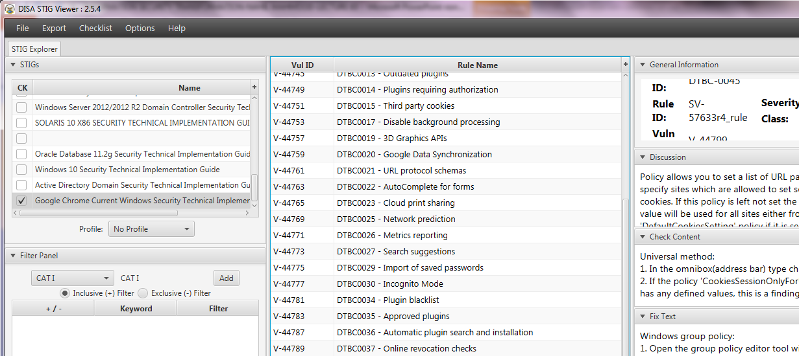
Security Hardening – Case Study - Chrome
STIGVIEWER WINDOW

Slide 3
Security Hardening – Case Study - Chrome
General Information:
Rule Title : Session only based cookies must be disabled.

Slide 4
Security Hardening – Case Study - Chrome
General Information:
Vuln ID: V-44799
STIG ID: DTBC-0045
Severity: CAT I

Slide 5
Security Hardening – Case Study - Chrome
Discussion:
Policy allows you to set a list of URL patterns that specify sites which are allowed to set session only cookies. If this policy is left not set the global default value will be used for all sites…

Slide 6
Security Hardening – Case Study - Chrome
Discussion:
…either from the 'DefaultCookiesSetting' policy if it is set, or the user's personal configuration otherwise. If the 'RestoreOnStartup' policy is set to restore URLs from…

Slide 7
Security Hardening – Case Study - Chrome
Discussion:
…previous sessions this policy will not be respected and cookies will be stored permanently for those sites

Slide 8
Security Hardening – Case Study - Chrome
Check Content:
Universal method: 1. In the omnibox (address bar) type chrome://policy 2. If the policy 'CookiesSessionOnlyForUrls' exists, and has any defined values, this is a finding…

Slide 9
Security Hardening – Case Study - Chrome
Check Content:
…Windows method: 1. Start regedit 2. Navigate to HKLM\Software\Policies\Google\Google Chrome\Content Settings\CookiesSessionOnlyForUrls 3. If this key exists and has any defined values, this is a finding

Slide 10
Security Hardening – Case Study - Chrome
Fix Text:
Windows group policy: 1. Open the group policy editor tool with gpedit.msc

Slide 11
Security Hardening – Case Study - Chrome
Fix Text…:
2. Navigate to Policy Path: Computer Configuration\Administrative Templates\Google\Google Chrome\Content Settings Policy Name: Allow session only cookies on these sites Policy State: Disabled Policy Value: N/A...

Slide 12
Security Hardening – Case Study - Chrome
CCI (Control Correlation Identifier):
CCI-000166 The information system protects against an individual (or process acting on behalf of an individual) falsely denying having performed…

Slide 13
Security Hardening – Case Study - Chrome
CCI (Control Correlation Identifier):
…organization-defined actions to be covered by non-repudiation. NIST SP 800-53 :: AU-10 NIST SP 800-53A :: AU-10.1 NIST SP 800-53 Revision 4 :: AU-10

